Slide 1
Stylegan Style Transfer
Cameron Barrie

Slide 2
Recap of Stylegan
Uses generative adversarial networks (GANs) to transfer style from one image to another
Instead of image input layer traditionally used by GANs, Stylegan’s input layer is used with a learned latent vector
Can manipulate styles at 9 different levels of granularity (4² px², 8 px, … 1024² px)

Slide 3
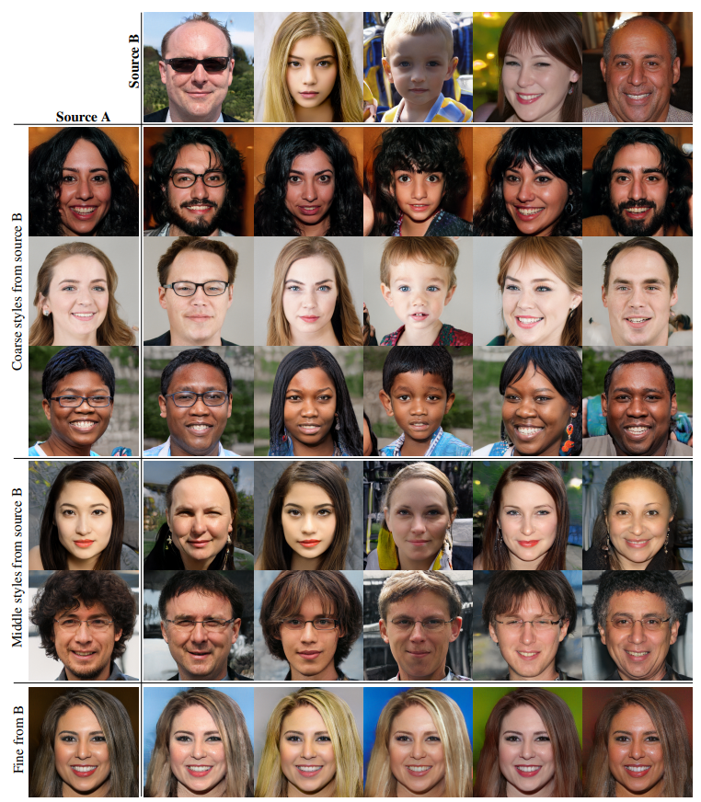
Example Style Transfers
Styles transferred from Source B images Source A images
Granularity categories
Course (4² – 8² pixels): pose, hair style, face shape, glasses, etc.
Middle (16² – 32² pixels): detailed hair style, eyes, etc.
Fine (64² – 1024² pixels): color scheme, microstructure, etc.

Slide 4
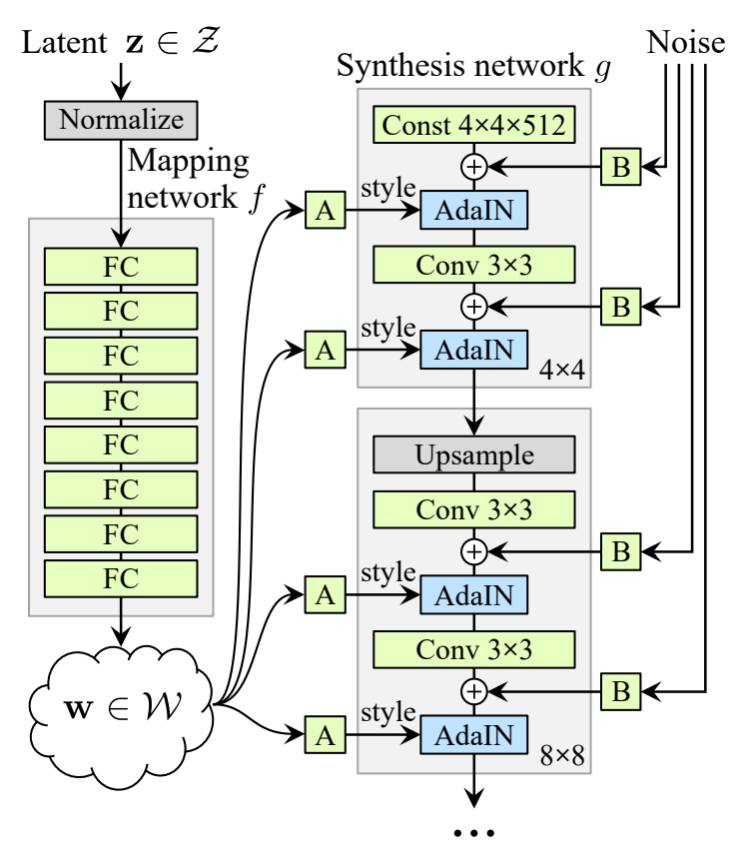
How Stylegan works
Mapping network: pass z (512 element vector) through 8-layer MLP to produce w (18 x 512 matrix)
Basically maps 512 element input vector to a set of 18 output vectors (one for each layer)
Used to disentangle data (necessary to “fill” gaps where feature combinations are absent)
Normalization of “A”
adaptive instance method (AdaIN)
includes style information
Notes:
Talk about both mapping network and synthesis network

Slide 5
Going Beyond Stylegan
Apply trained network to a given image (that is not in the training set)
Develop interface allowing users to upload photos
Allow users to apply Stylegan to their own images For example:
Selecting one of a collection of images from which the style will be transferred to the uploaded image
Selection of style granularity to apply to the uploaded image

Slide 6
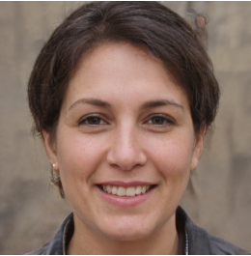
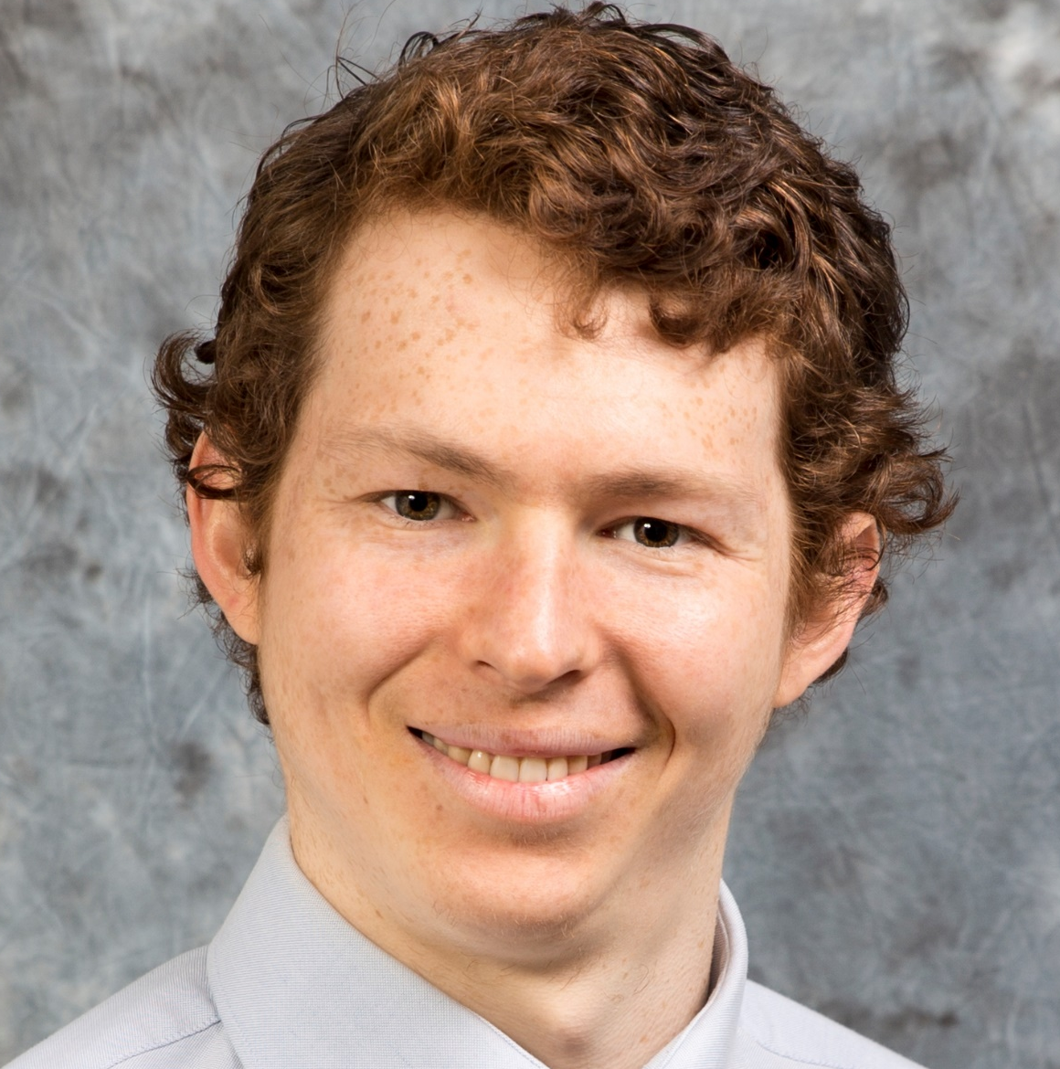
Example Usage
Style Transfer Image
?
Uploaded Image

Slide 7
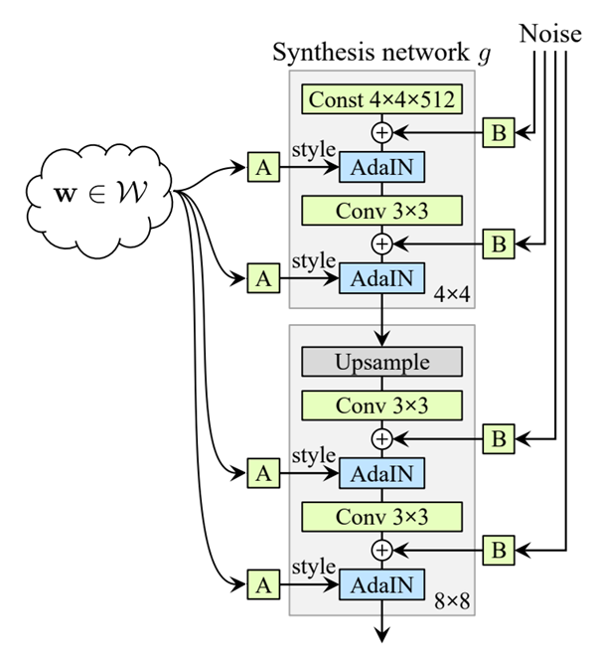
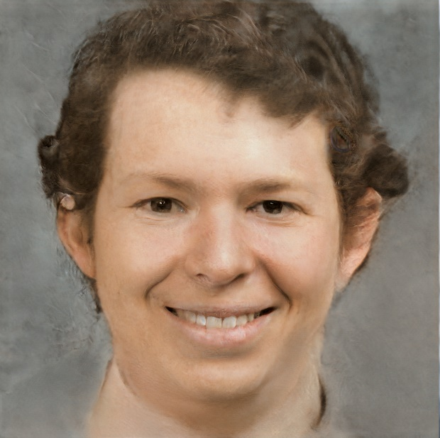
Convert Image to Latent Space (Z or W)
Evaluate loss and update w value
Notes:
Stylegan latent space made up of only synthetic training images
Need a way to convert real images to stylegan latent space
Answer is to train a w vector on the synthesis network
Unfortunately ran into some issues implementing loss function and given the time constraints, was not able to get loss function working on my own.
Ended up using a project that was doing something similar work.
This project performed preprocessing tasks that would have required much more time for me to implement, such as correctly aligning the face in the image.
It also used a more sophisticated loss function instead of mean-squared error

Slide 8
Learning of Latent Space Representation
VGG-16 Perceptual Loss (Johnson, et al.)
Extracts high-level features from image at each abstraction level (4² pixels – 1024² pixels)
Minimizes loss between these features for each of these levels
Much faster than using mean-squared error alone
Notes:
In particular, instead of pixelwise mean-squared error, the project used VGG-16

Slide 9
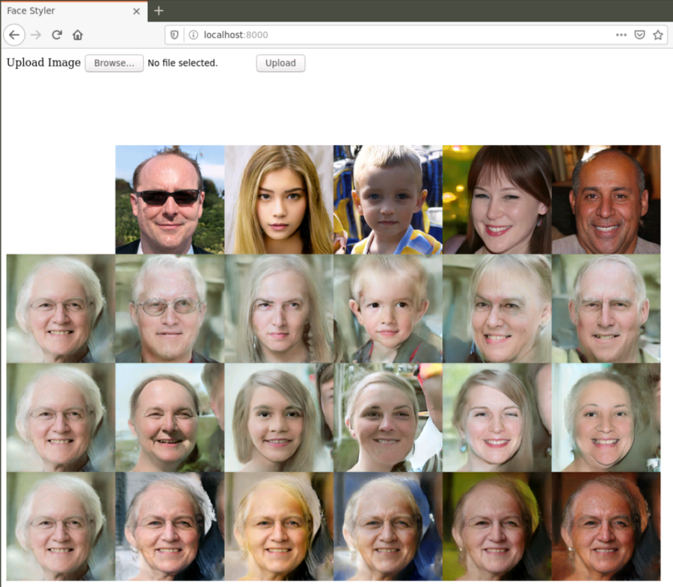
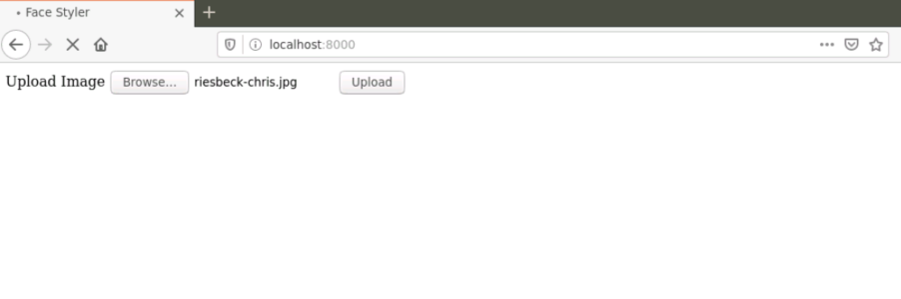
Interface
Upload Get Style-Mixing Results
5-ish minutes

Slide 10
Next Steps
Attempt to improve image learning
Possibly by using a combination of VGG-16 perceptual loss and mean-squared error loss
Improve UI
Add more functionality
Ability to upload multiple photos
Ability to select which photos to apply style from
More controls to fine tune style transfer
More graphically interesting

Slide 11

Sample Results / Questions

Slide 12
